Slide 1

A Hybrid Approach for Detecting Cyberbullying on Social Media Platform using Machine Learning Algorithm
B410
B410
B410
SRM INSTITUTE OF SCIENCE AND TECHNOLOGY
SCHOOL OF COMPUTING
DEPARTMENT OF COMPUTING TECHNOLOGIES
18CSP109L - MAJOR PROJECT
BATCH ID:B415
GUTTA KOTESWARARAO, RA1911003010621
B.S.K.BHARADWAJ, RA1911033010109
Guide: Dr. Vegesna S M Srinivasavarma,
Research. Asst. Prof., Dept. of CTech, SRMIST

Slide 2
Table of Contents
S.No | Title | Page No.
1 | Abstract | 3
2 | Introduction to project | 4
3 | Motivation | 5
4 | Literature Survey | 6
5 | Challenges and limitations in existing system | 11
6 | Objective | 14
7 | Innovation | 16
8 | Applications | 17
9 | Scope | 19
10 | Architecture | 20
11 | Modules | 21
12 | Algorithms | 24
13 | UML Diagrams | 26
14 | Results | 30
15 | References | 31

Slide 3
ABSTRACT
Cyberbullying is becoming more common on social media platforms. Given the popularity and prevalence of social media by people of all ages, it is very important to protect social media platforms from cyberbullying.
This study focuses on how to identify, understand the comments and detect the cyberbullying by using different algorithms.

Slide 4
Introduction
Social media applications such as Instagram, twitter, facebook, whatsapp etc have become most used and preferred platforms for interaction between people across the globe. These platforms enable people to communicate in different ways, it also leads to vicious ways.
Our proposed work provides a way in detecting cyberbullying using algorithms such as logistic regression, SVM, Decision tree classifier, ada boost classifier, GaussianNB, random forest and MLP classifier and evaluate the best possible way in detection.

Slide 5
Motivation
Our aim is to identify and detect cyberbullying on social media platforms. Where we try to find the best way possible of detect bullying in comments, texts by using different Machine learning algorithms.
The existing papers focused on classifying only one social media ie twitter. But cyberbullying also do exists in different applications. In this paper we are going to do research on different application.

Slide 6
Literature Review
Serial Number | Title | Authors | Year of Publication | Methodology | Conclusion
1) | Detection of Hate Tweets using Machine Learning and Deep Learning | Lida Ketsbaia, Biju Issac, Xiaomin Chen | 2020- IEEE 19th International conference on Trust,Security and Privacy in Computing and Communications | The paper explores machine learning approaches using word embeddings such as Distributed Bag of Words and Distributed Memory Mean and the performance of Word2vec Convolutional Neural Networks (CNNs) to classify online hate. | This paper used several methods for two data sets linear SVC produced highest accuracy and Bernoulli naïve Bayes produced lowest. using continuous bag of words + CNN resulted them an accuracy of 94% and 98.20% of accuracy while integrating CNN + Skipgram

Slide 7
Literature Survey
Serial Number | Title | Authors | Year of Publication | Methodology | Conclusion
2) | Cyber-Bullying Detection in Social Media Platform using Machine Learning | Vaibhav Jain, Ashendra Kumar Saxena, Dr. Athithan Senthil, Abhishek Jain, and Arpit Jain, | 2021 | This paper explored various forms for cyber crime and collected 35000+ tweets and then applied ML algorithms to those tweets for classification and prediction. | They used five machine learning algorithms bagging classifier, SGD classifier, decision tree, random forest, and K-neighbours and concluded SGD classifier has recorded the better accuracy (92.9%) compared to others.

Slide 8
Literature Survey
Serial Number | Title | Authors | Year of Publication | Methodology | Conclusion
3) | Optimized Twitter Cyberbullying Detection based on Deep Learning | Monirah A. Al-Ajlan, Mourad Ykhlef | 2018-21st Saudi Computer Society National Computer Conference | In this paper they proposed an optimised twitter cyberbullying detection based on deep learning(OCDD) using CNN | They explored new detection techniques using training data by human intelligence and word embedding was for each word using Glo Ve technique. CNN was used for classifying. Which gave great results on text mining tasks however not used on cyberbullying detection context.

Slide 9
Literature Survey
Serial Number | Title | Authors | Year of Publication | Methodology | Conclusion
4) | Cyberbullying Detection using Pre-Trained BERT Model | Jaideep Yadav, Devesh Kumar, Dheeraj Chauhan | 2020- International Conference on Electronics and Sustainable Communication Systems(ICESC) | A new Approach is proposed to cyberbullying detection using pre-trained BERT model with a single linear neural network layer on top as classifier | In this approach of using pre-trained BERT model which is based on the complex and novel deep neural network using single linear linear layer of neural network gives better and stable results compared to CNN.

Slide 10
Literature Survey
Serial Number | Title | Authors | Year of Publication | Methodology | Conclusion
5) | Cyberbullying Detection using Recursive Neral Network through offline Repository | Nidhi Chandra, Sunil Kumar Khatri, Subhranil Som | 2018- 7th International Conference on Reliability, Infocom Technologies and Optimization (ICRITO) | This paper proposed a prediction method of the user behaviour on his posts on social networking sites specifically twitter tensorflow apis have been used to predict analysis.NLP is applied to break text and CNN for classifying images. | This experiment presents classifying cyberbullying and cyber trolling. Tensorflow contribution library is used to generate the prediction from data set. And converted training and test set into Numpy array.

Slide 11
Challenges
Data collection:
Collecting and labeling data for training machine learning models is a time-consuming and challenging task, especially for sensitive topics like cyberbullying. The quality of the training data will have a significant impact on the accuracy and effectiveness of the system.
Developing robust models:
Building machine learning models that can accurately detect instances of cyberbullying can be challenging, as the language and behavior used in cyberbullying can be complex and diverse. Developing models that are robust enough to handle these complexities is a significant challenge.
Addressing the issue of false positives and false negatives:
The system should be designed in such a way that it does not produce too many false positives or false negatives, as this could result in unnecessary warnings or missed instances of cyberbullying.

Slide 12
Challenges
Handling multi-lingual content:
WhatsApp is used in several countries with multiple languages, and the system must be capable of handling messages in different languages.
Ensuring privacy and security:
The system should be designed to protect user privacy and security while detecting instances of cyberbullying.
Adapting to new and emerging types of cyberbullying:
The system should be designed to adapt to new and emerging forms of cyberbullying, which can be challenging given the constantly evolving nature of online behavior.

Slide 13
Challenges
Bullying could be hard to detect if the bully chooses to disguise it through techniques such as sarcasm or passive-aggression.
There are several works in the literature concerning detecting malicious users from unsigned networks with positive edge weights, including community detection , node classification and link prediction.
The third Party Application which we use for sending text messages directly to persons mobile is consuming longer time`

Slide 14
Objective
To develop an effective system for automatically detecting instances of cyberbullying on WhatsApp using a hybrid approach that combines rule-based and machine learning techniques.
To improve the accuracy and efficiency of cyberbullying detection compared to existing state-of-the-art methods.
To develop a system that is capable of handling the complexities of language and behavior used in cyberbullying and can detect new and emerging forms of such behavior.

Slide 15
Objective
To ensure that the system protects user privacy and security while detecting instances of cyberbullying.
To explore the potential applications of the system in social media platforms, educational institutions, law enforcement agencies, and mental health professionals.
To contribute to the growing body of research on the use of machine learning for cyberbullying detection and prevention.

Slide 16
Innovation
Detecting the abusive words in social media platforms using machine learning algorithms.
All the existing models focused on detecting cyberbullying in a single platform (twitter) but, this model focuses on detecting cyberbullying on whatsapp platform as well.
In this model we are going to detect the cyberbullying in the whatsapp through analysis the messages we receive from the contacts.

Slide 17
Applications
Social media platforms:
The hybrid approach can be integrated into social media platforms like WhatsApp to automatically detect and flag instances of cyberbullying, which can help protect users from the negative effects of such behavior.
Educational institutions:
The system can be used in educational institutions to monitor and detect instances of cyberbullying among students. This can help educators identify and address such behavior and create a safer and more supportive learning environment.

Slide 18
Applications
Law enforcement agencies:
The system can be used by law enforcement agencies to monitor and detect instances of cyberbullying, which can help prevent online harassment and victimization.
Mental health professionals:
The system can be used by mental health professionals to identify and monitor instances of cyberbullying, which can help them provide support and interventions to individuals who may be experiencing negative effects from such behavior.

Slide 19
Scope
The scope of this project is to develop a system that can automatically detect instances of cyberbullying in WhatsApp messages. The system will use a combination of rule-based and machine learning techniques to identify instances of cyberbullying. The data preprocessing will involve data cleaning, feature extraction, and selection, and will be followed by the training of multiple machine learning models.
The system will be evaluated on its accuracy, precision, and recall, and will be compared to existing state-of-the-art methods. The ultimate goal is to develop a system that can help prevent and mitigate the harmful effects of cyberbullying on social media.

Slide 20
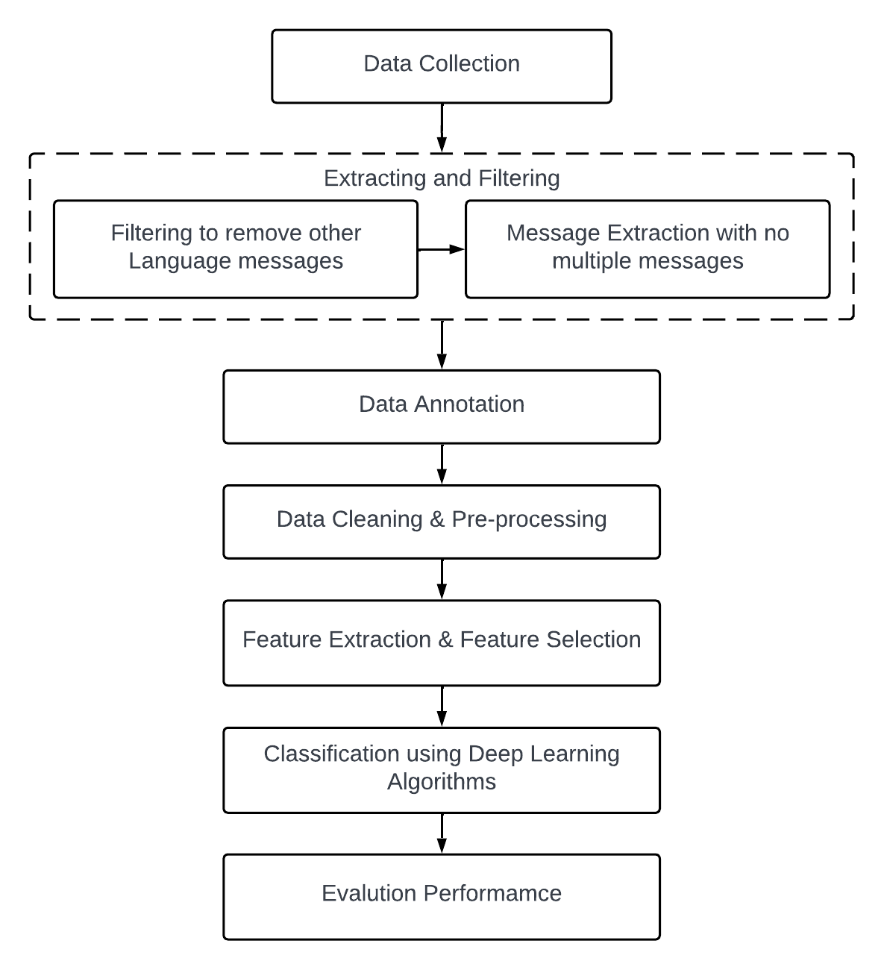
Proposed Architecture
10.1 Architecture

Slide 21
Proposed Modules
Extracting and filtering:
Extracting and filtering of data are two important data processing tasks that are often used in data analysis and machine learning.
Extracting data refers to the process of selecting and retrieving specific data from a larger dataset. This is typically done when we want to focus on a particular subset of the data that is relevant to our analysis. Extraction can involve selecting specific columns or rows of data based on some criteria, such as a date range, a particular category or tag, or a specific data value. Extraction can be performed using tools such as database queries, scripting languages like Python, or data visualization software.

Slide 22
Proposed Modules
Data Annotation:
Data annotation is the process of labeling or adding metadata to a dataset to make it more informative and useful. It involves manually adding tags, notes, or comments to individual data points or groups of data points.
Data Cleaning and Preprocessing:
Data cleaning and preprocessing are essential steps in data analysis and machine learning. They involve identifying and handling missing or inaccurate data, removing duplicates, and transforming the data into a format suitable for analysis or modeling.

Slide 23
Proposed Modules
Feature Extraction and Feature Selection:
Feature Extraction and Feature Selection are both techniques used to reduce the dimensionality of data in machine learning. Feature Extraction involves transforming raw data into a set of meaningful features that can be used to train a model, while Feature Selection involves selecting a subset of the most relevant features from the original dataset.

Slide 24
Algorithms
Support Vector Machine (SVM) is a type of supervised learning algorithm that aims to find the best separating boundary (hyperplane) between different classes of data. The algorithm uses a kernel function to map the input data into a high-dimensional feature space, where the boundary can be found more easily.
Logistic Regression is also a type of supervised learning algorithm that is used for classification tasks. It models the probability of the outcome variable (i.e., the class label) given the input data. Logistic regression assumes a linear relationship between the input features and the log-odds of the outcome variable.

Slide 25
Algorithms
Ada boost classifier It is a boosting algorithm that combines multiple weak classifiers into a single strong classifier.
Decision tree classifier is a type of supervised learning algorithm that is used for classification tasks. It splits the data into subsets based on the values of different features.
Gaussian Naive bayes machine learning algorithm for classification tasks. It is a variant of the Naive Bayes algorithm, which assumes that the features are independent of each other given the class label.

Slide 26
Algorithms
Random Forest is a popular ensemble learning method used for classification, regression, and other machine learning tasks. It is based on decision trees and combines the predictions of multiple decision trees to improve accuracy and reduce overfitting.
Multilayer percepton classifier (MLP) is a type of neural network that is widely used in machine learning for classification tasks. It is based on the concept of feedforward neural networks, which consist of multiple layers of interconnected nodes, or neurons.

Slide 27
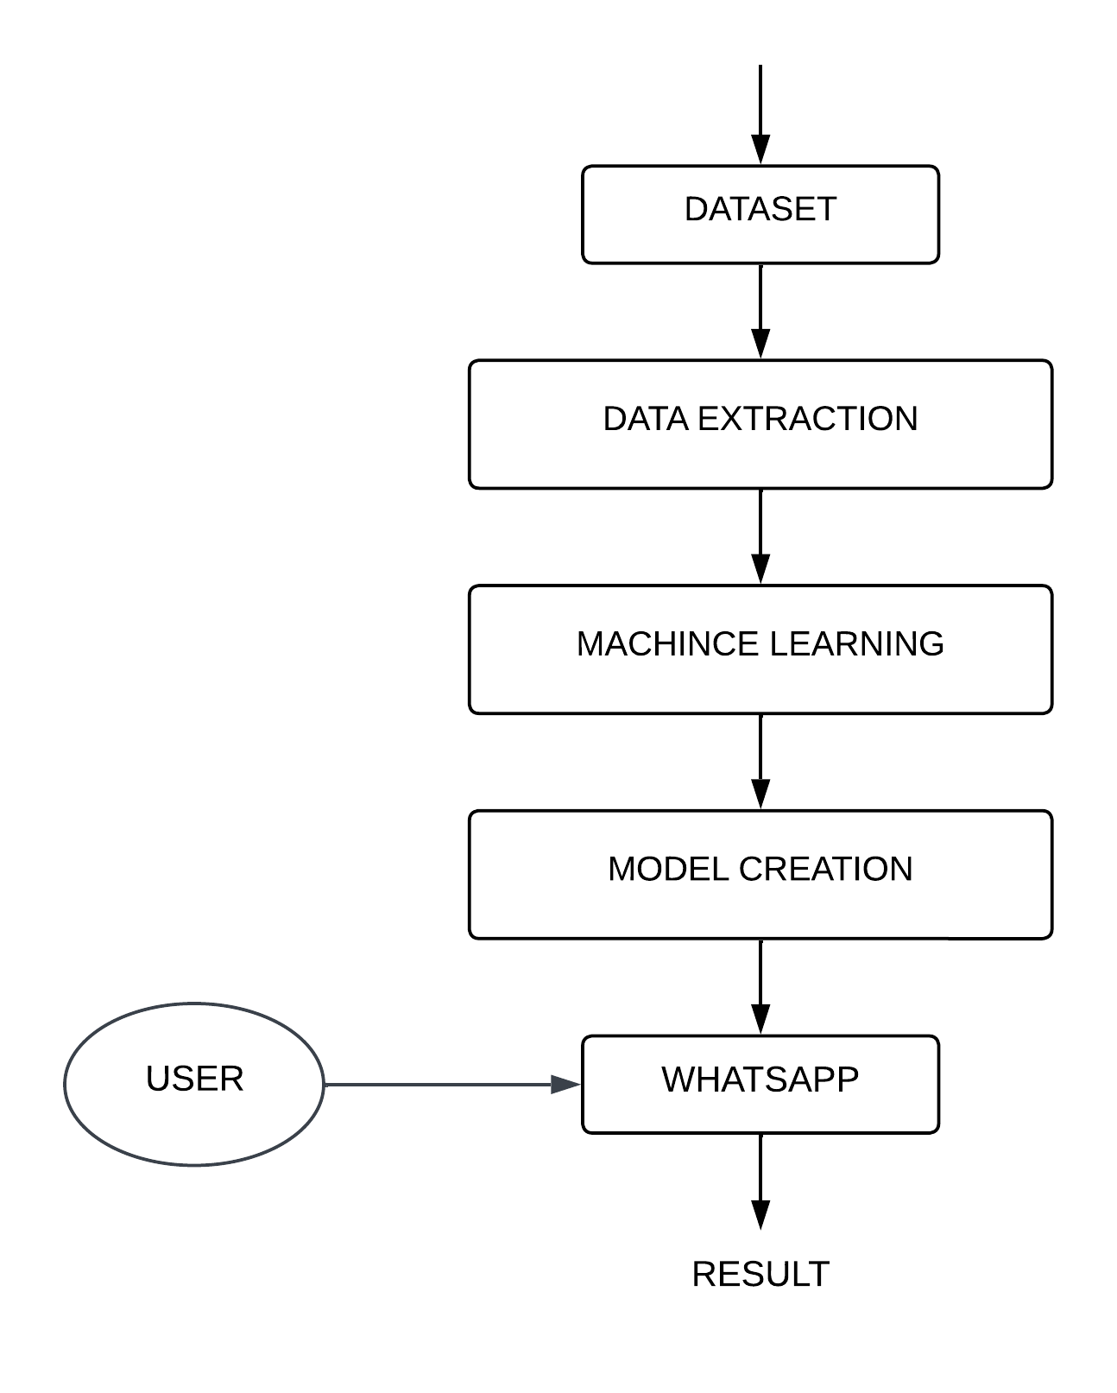
UML Diagrams
13.1 Activity Diagram

Slide 28
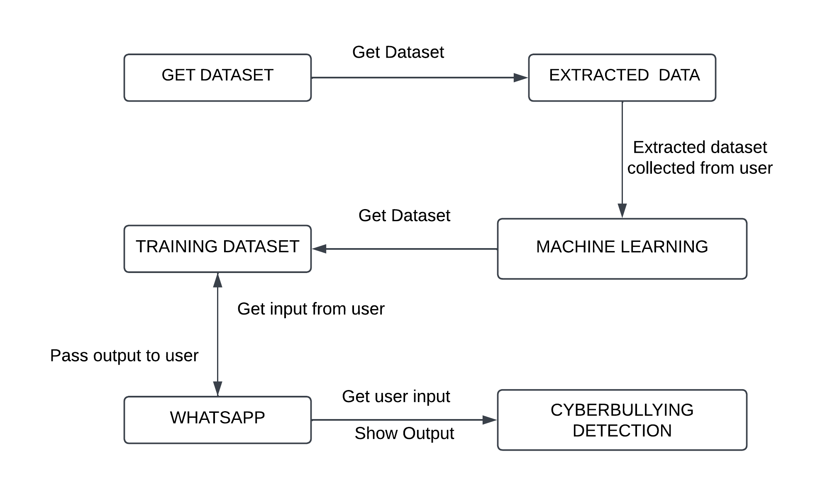
UML Diagrams
13.2 Collaboration Diagram

Slide 29
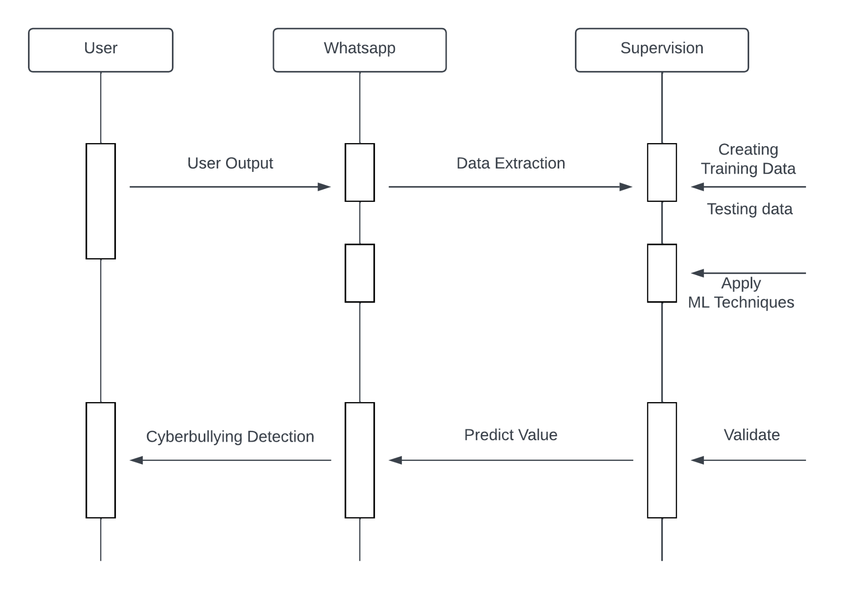
UML Diagrams
13.3 Sequence Diagram

Slide 30
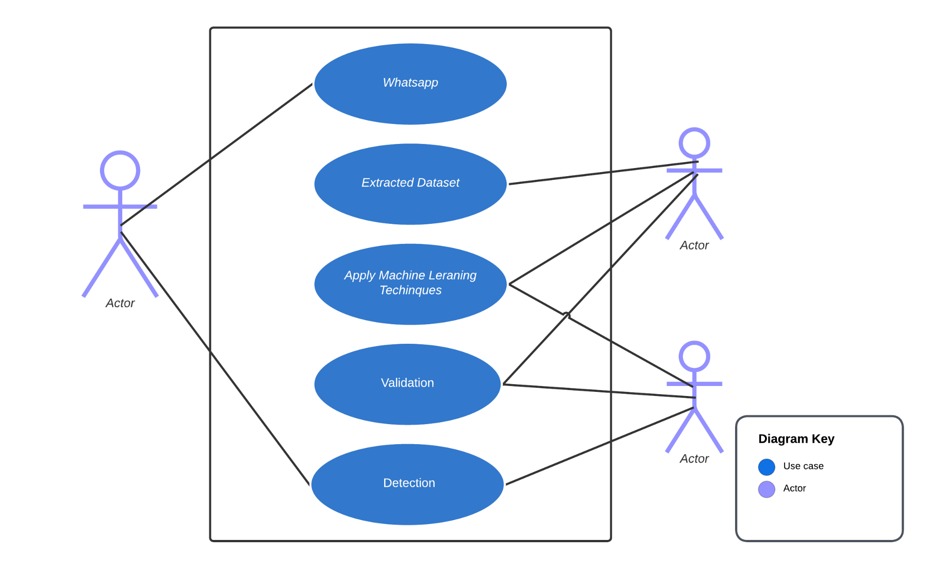
UML Diagrams
13.4 Usecase Diagram

Slide 31
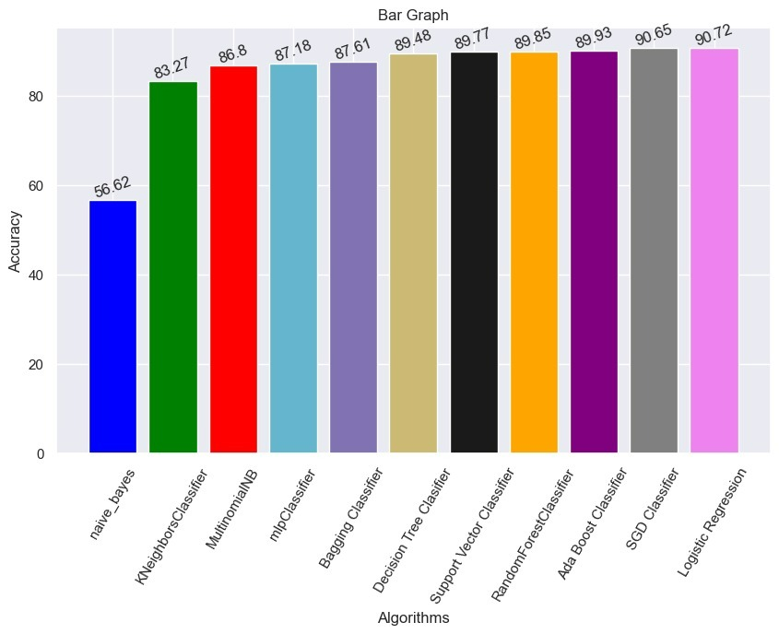
Results
14.1 Accuracy

Slide 32
References
Lida Ketsbaia, Biju Issac and Xiaomin Chen, “Detection of Hate Tweets using Machine Learning and Deep Learning,” in Proc. of the 19th IEEE International conference on Trust, Security and Privacy in Computing and Communications, Guangzhou, China, pp. 751-758, 2020.
Vaibhav Jain, Ashendra Kumar Saxena, Dr. Athithan Senthil, Abhishek Jain, and Arpit Jain, “Cyber-Bullying Detection in Social Media Platform using Machine Learning” in Proc. of the 10th International Conference on System Modeling & Advancement in Research Trends (SMART), Morabad, India, pp. 401-405, 2021.
Monirah A. Al-Ajlan, and Mourad Ykhlef, “Optimized Twitter Cyberbullying Detection based on Deep Learning,” in Proc. of the 21st Saudi Computer Society National Computer Conference (NCC), Riyadh, Saudi Arabia, pp. 1-5, 2018.
Jaideep Yadav, Devesh Kumar, and Dheeraj Chauhan, “Cyberbullying Detection using Pre-Trained BERT Model,” in Proc. of the International Conference on Electronics and Sustainable Communication Systems (ICESC), Coimbatore, India, pp. 1096-1100, 2020.
Nidhi Chandra, Sunil Kumar Khatri, and Subhranil Som, “Cyberbullying Detection using Recursive Neral Network through offline Repository,” in Proc. of the 7th International Conference on Reliability, Infocom Technologies and Optimization (Trends and Future Directions) (ICRITO), Noida, India, pp. 748-754, 2018.

Slide 33
References
Samghabadi, Niloofar Safi, et al. ”Detecting nastiness in social media.” Proceedings of the First Workshop on Abusive Language Online. 2017.
R. R. Dalvi, S. Baliram Chavan and A. Halbe, Detecting A Twitter Cyberbullying Using Machine Learning, ICICCS, pp. 297-301, doi: 10.1109/ICICCS48265.2020.9120893. (2020)
N. Silva, D. L. Hall, C. Rich, BullyBlocker: toward an interdisciplinary approach to identify cyberbullying. Social Network Analysis and Mining. 8 (2018), doi:10.1007/s13278-018-0496-z
Burnap, P. and M.L. Williams, Us and them: identifying cyber hate on Twitter across multiple protected characteristics. EPJ Data Science, 2016. 5(1): p. 11.
Gitari, N.D., et al., A lexicon-based approach for hate speech detection. International Journal of Multimedia and Ubiquitous Engineering, 2015. 10(4): p. 215-230.
Tulkens, S., et al., A dictionary-based approach to racism detection in dutch social media. arXiv preprint arXiv:1608.08738, 2016.

Slide 34
References
Jain, A., Gahlot, A. K., Dwivedi, R., Kumar, A., & Sharma, S. K. (2018). Fat Tree NoC Design and Synthesis. In Intelligent Communication, Control and Devices (pp. 1749-1756). Springer, Singapore.
Kumar, Sandeep, E. G. Rajan, and Shilpa Rani. “A Study on Vehicle Detection through Aerial Images: Various Challenges, Issues and Applications.” In 2021 International Conference on Computing, Communication, and Intelligent Systems (ICCCIS), pp. 504-509. IEEE, 2021
Dinakar, K., R. Reichart, and H. Lieberman. Modeling the detection of textual cyberbullying. In fifth international AAAI conference on weblogs and social media. 2011.
Liu, S. and T. Forss. Combining N-gram based Similarity Analysis with Sentiment Analysis in Web Content Classification. in KDIR. 2014.

Slide 35
Thank You

